Slide 1
Dealing with Imbalanced Datasets & Data Pre-Processing
In His Name, the Most High

Slide 2
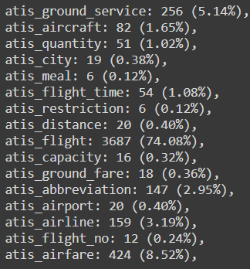
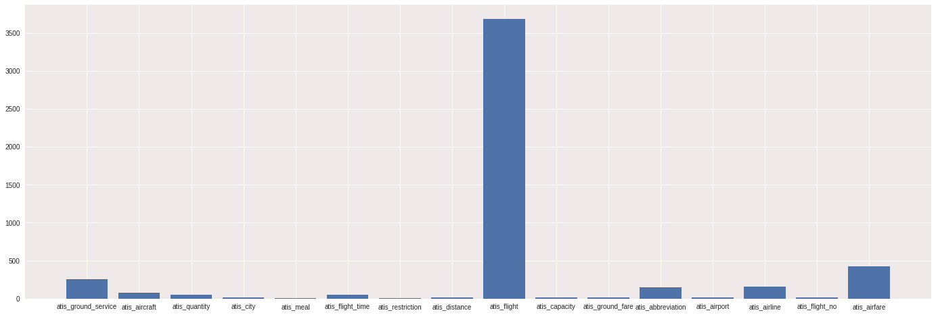
Intents are Imbalanced:

Slide 3
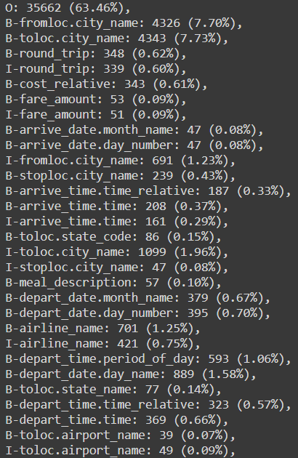
IOB tags are also Imbalanced:

Slide 4
Dealing with Imbalanced Datasets
Providing some bias to minority classes using weights …
Choosing the right metric for evaluating model
Re-sampling
Papers
Two stages ?

Slide 5
Re-sampling
Under-sampling
Over-sampling
SMOTE (Synthetic Minority Over-sampling Technique)
ADASYN (Adaptive Synthetic)
Manual augmentation / resampling (augmenting data using language translation or replacing words with synonyms - removing similar samples from majority class - …)

Slide 6
Under-sampling
For huge datasets
Removing similar samples from majority classes (Jaccard similarity – Cosine similarity - …)
Samples with multiple intents
not suitable for ATIS dataset?
Operation on vector space

Slide 7
Over-sampling
suitable for ATIS dataset?
For small datasets
SMOTE
ADASYN
Augmenting data using language translation or removing unimportant words …
Augmenting data by substituting words with synonyms / contraction
Requires vectorization (BoW or W2V or …) and not applicable directly on NLP tasks …
Requires lots of manual editing …
Requires some manual editing

Slide 8
Pre-processing
Converting to lower case and tokenization and Removing punctuation 🗸
Numbers ?
handling samples with multiple intents 🗸
Removing misspellings and stop words ?
Lemmatization / stemming ✗
Re-sampling and manual augmentation 🗸 ✗

Slide 9
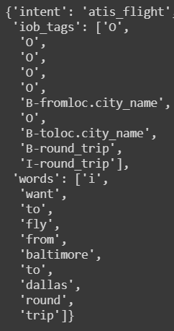
Data structure: List of dictionaries

Slide 10
Thanks

